Slide 1
ABC Product Sales Analysis
- Shubham Mishra

Slide 2
Understanding Sales data

Slide 3
Shape of dataset
Row count – 540509
Column count - 8

Slide 4
Features of dataset
InvoiceNo - Unique number assigned to a shipment for billing purpose
StockCode – Kind of item id
Description - Product name
Quantity - Amount purchased
InvoiceDate - Date and time of purchase
UnitPrice - Cost of product
CustomerID - Unique id for customer
Country - Contry of purchase

Slide 5
Data Cleaning
Check for null values and correct them
Corrected the datatypes of features
Corrected column names
Removed quantities with negative values
Removed description with nan values

Slide 6
Time for some insights about data

Slide 7
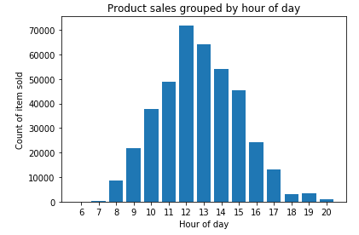
Looks like the highest number of product sales are made in the afternoon at 12 p.m. and sales fall after the evening till morning at 6 a.m. This may be because people make most purchases in the afternoon.

Slide 8
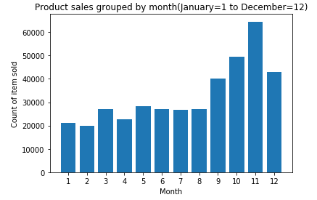
The highest count of the item was sold in the month of November. This may be due to there is some kind of promotional or seasonal sale on the products in the month of November.

Slide 9
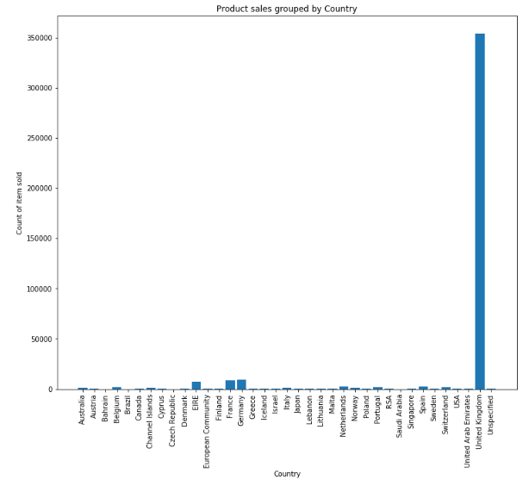
From this figure we know that ABC company has the highest market in United Kingdom.

Slide 10
Recommender System (Market Basket Analysis)

Slide 11
Some order statistics
Total orders entries: 397478
Unique orders: 18510
Unique items bought: 3665

Slide 12
Approach – Apriori Algorithm
Association rule mining metrics used
Support – It is the percentage of orders that contain item set
Eg – support{a,b} = 3/5 i.e. 3 out of 5 orders contain a and b both
Confidence - Given two items, A and B, confidence measures the percentage of times that item B is purchased, given that item A was purchased.
This is expressed as: confidence{a->b} = support{a,b} / support{a}
Lift - Given two items, A and B, lift indicates whether there is a relationship between A and B, or whether the two items are occurring together in the same orders simply by chance (ie: at random).
Lift{a,b} = lift{b,a} = support{a,b} / (support{a} * support{b})

Slide 13
Approach – Apriori Algorithm Contd…
By using previously shown metrics I have built a function to generate the parameters for pairs of all of our products
The product pairs are filtered level by level based on a threshold
After the function is done performing the calculation for all metrics we get results in the form of a data frame
We can now filter pairs based on required criteria
I filtered the results based on lift value as it is the most important factor to determine pairs bought together and it is not random

Slide 14
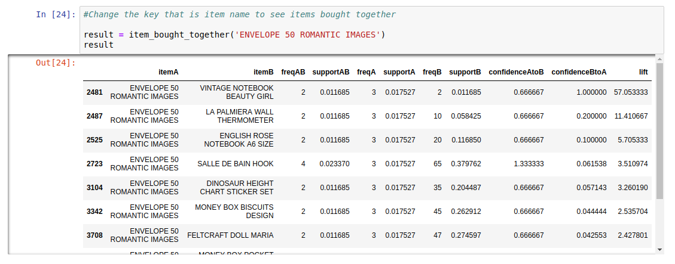
How to use the function
To get the result i.e. items that are bought with ‘x’ item, you just have to key in the item name and you’ll get the list of the item bought with key
Eg – Shown in picture
This function can be used by front end developer to receive the details of products and display it with ‘x’ item as Amazon does

Slide 15
Conclusion
After performing analysis using my function, Sales Director can easily find out the list of product bought together with the given product description
This function can be used to pull the information of the products on web layout and display it as recommendation besides purchase cart to grab buyer attention
Finally, ABC company can now increase it’s ticket size as buyers may also purchase recommended products and thereby increase profits for ABC

Slide 16
Time Series Prediction Top 10 Products

Slide 17
Approach
Find top 10 selling products (Assumption)
Keep data for only these 10 products, discard rest
Check seasonality in sale using seasonal decomposition parameters like a trend, seasonal and residual
Product wise train-test split
Grid search for hyper-parameters and keep the one which gives good RMSE score
Implement SARIMAX model and feed the data
Predict the quantity required for 12 weeks

Slide 18
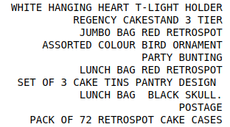
Assumption
Assuming that the ABC company ranks top products based on the first quantity of product sold and then the frequency of purchase made.
After performing analysis based on the above assumption, I found out the top 10 products
Let’s see what these products are in the picture

Slide 19
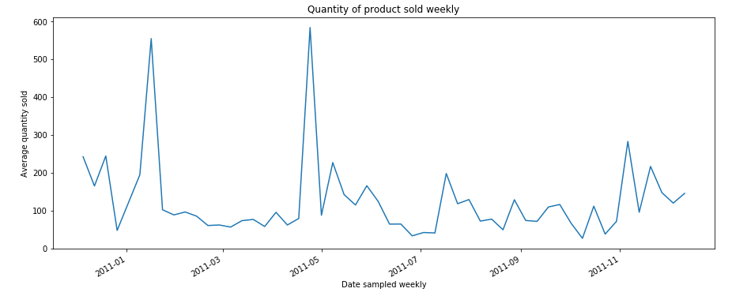
Visualized sales of one of the products

Slide 20
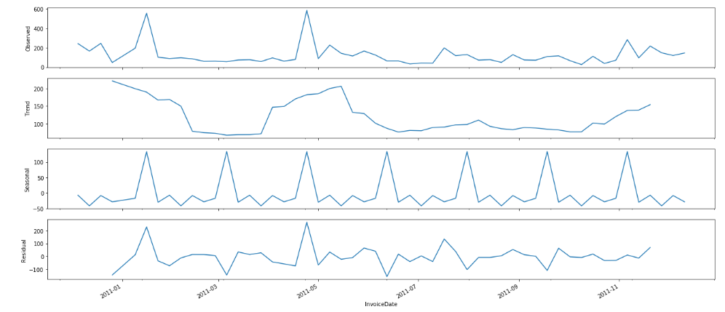
Time Series decomposition
This plot here clearly shows that sales of this product are unstable with seasonality
I have created a handy function in which the user can key in the product name and all the decompositions are displayed

Slide 21
ARIMA
It is Autoregressive Integrated Moving Average or ARIMA
This is most widely used forecasting methods from stats models library in python for data forecasting
I used this method but it didn’t perform well on our data
One of the reasons for not performing well as it could only handle the trend component of data
Another reason for not performing well was an obvious seasonal component that this model does not handle
This led me to implement another model which can perform well on our data

Slide 22
SARIMA(Our model)
SARIMA is extension to ARIMA model with ability to directly model seasonal component
SARIMA can also be called as Seasonal ARIMA
It has 4 seasonal hyper-parameters
Autoregression(AR) a.k.a. P
Differencing(I) a.k.a. D
Moving Average(MA) a.k.a. Q
Seasonality a.k.a. m
It also has 3 trend hyper-parameters like ARIMA
Autoregression(AR) a.k.a. p
Differencing(I) a.k.a. d
Moving Average(MA) a.k.a. q

Slide 23
Implementation
I have kept a driver code which takes all top 10 product and perform analysis on them automatically
Steps followed while performing analysis:
Building data based on the product description passed, which includes preparing the index, resampling data for weekly analysis and dropping nan in any
Train-test split of 80-20 is done conventionally
Generate combinations of hyper-parameter
Run model on these parameters to find the best one
Use the best parameters to predict the final results

Slide 24
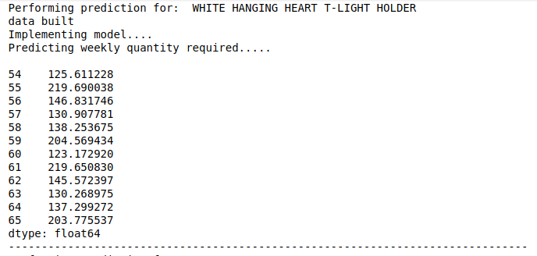
Results
Finally, after running the driver code user will automatically get the name of the top product and its 12-week stock prediction one by one
In the picture, you can see results for one of the top products

Slide 25
Conclusion
Using my program user can do the following things:
Find the top 10 selling products
Check seasonality in their sales
Perform quantity predictions on a weekly basis
After using this prediction results, I can assure Head of Supply Chain that inventory levels of these products can be extracted and used to stock up the items for weekly sale
With this ABC company can now meet the customer demands and lower the inventory cost and reduce wastage

Slide 26
References
https://medium.com/activewizards-machine-learning-company/top-10-data-science-use-cases-in-retail-6483accc6042
https://elitedatascience.com/birds-eye-view
https://pandas.pydata.org/pandas-docs/stable/
https://towardsdatascience.com/various-implementations-of-collaborative-filtering-100385c6dfe0
https://towardsdatascience.com/a-gentle-introduction-on-market-basket-analysis-association-rules-fa4b986a40ce
https://anomaly.io/seasonal-trend-decomposition-in-r/
https://stackoverflow.com/questions/17001389/pandas-resample-documentation
https://www.statsmodels.org/stable/index.html
https://www.statsmodels.org/dev/generated/statsmodels.tsa.statespace.sarimax.SARIMAX.html

Slide 27
Thank you

